Slide 1
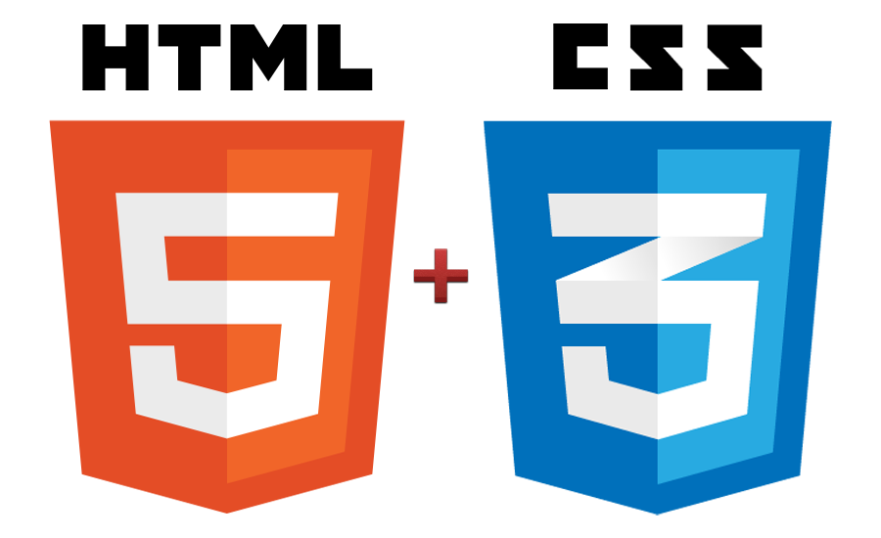
COMPSCI 345 / SOFTENG 350 tutorial
Week 8 | Sam Kavanagh

Slide 2
Agenda
HTML Basics
CSS Basics
What is DHTML?
JavaScript Basics
What is the DOM?
Form Validation
Dynamically Changing Visibility
Exercise

Slide 3
HTML, CSS & JavaScript
The three elements of modern web development
HTML – Content & Structure
CSS – Presentation
JavaScript – Behaviour/functionality

Slide 4
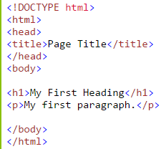
HTML – Hyper Text Markup Language
HTML is a markup language used for describing web pages
Markup languages are used to annotate documents in a way syntactically distinguishable from the text
HTML, TeX/LaTeX, Wiki markup etc.
HTML uses tags to differentiate between document content

Slide 5
HTML – Hyper Text Markup Language Cont.
The individual markup components are called HTML elements
White space is ignored
Written in ASCII / Unicode so can be edited by most text editors
No support: NotePad
Syntax highlighting: Notepad++ (http://notepad-plus-plus.org/)
Auto complete: Free HTML Editor (http://www.coffeecup.com/free-editor/)
Comprehensive: Adobe Dreamweaver (http://www.adobe.com/cfusion/tdrc/index.cfm?product=dreamweaver)
The standards for both HTML and CSS are maintained by W3C http://www.w3.org/

Slide 6
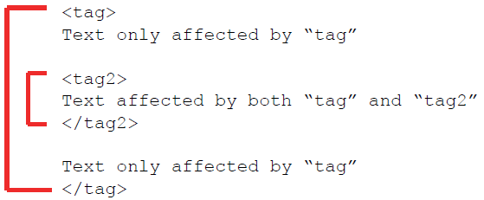
Overview of Tags
Markup achieved with tags
Enclosed in angle brackets < … >
Generally come in pairs <tag> … </tag>
For certain ‘void’ elements a closing tag is not required, e.g. <br />, <hr />
In HTML5 the self-closing syntax is simply syntactical sugar, so <br> and <hr> are also valid
Tags must be correctly nested

Slide 7
CSS – Cascading Style Sheets
CSS is used to control the style and layout of web pages
Separates web page content from its design
Used in conjunction with HTML
HTML is used for describing the content of a web page, CSS is used for describing its presentation

Slide 8
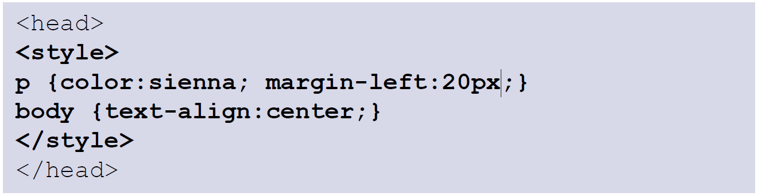
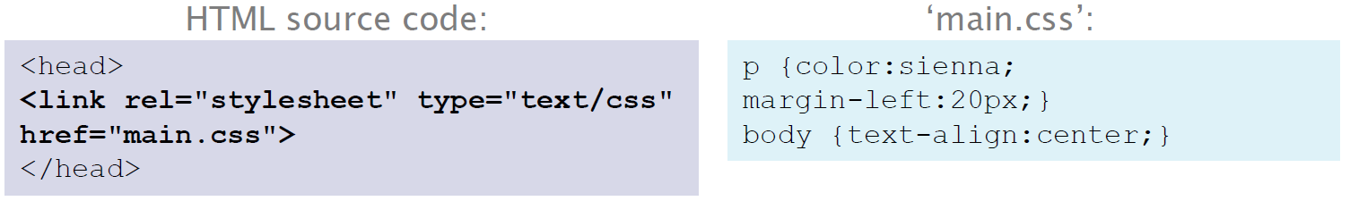
CSS – Cascading Style Sheets Cont.
Three ways to incorporate CSS:
Inline – style included as the attribute of an HTML tag:
Internal – CSS code is contained in the HTMLs head section:
External – Code resides in a separate .css file, which is then referenced in the HTML:

Slide 9
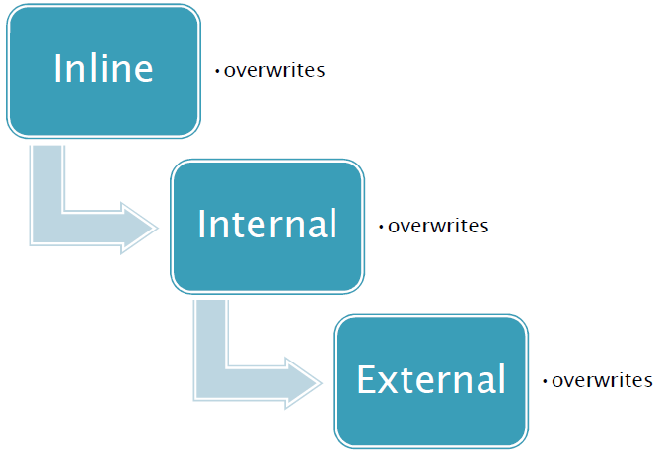
Cascade Rule
When web documents load in a browser, declarations are sorted and given a weighting
Declarations with the highest weight are give priority in case of a conflict
E.g. an elements text colour is set to blue in the external style sheet, and then set to red using inline-styling

Slide 10
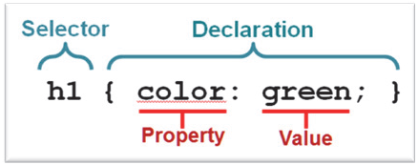
CSS Syntax
CSS rule has two main parts:
Selector:
Determines what the rule applies to
Usually the HTML element you want to style
Declaration:
Surrounded by curly braces { } and ends with a semicolon ;
Property – the attribute you want to change
Value – the value the property will be set to

Slide 11
Exercises
Use the W3Schools try-it-yourself editor to try styling each of these properties
W3Schools.com contains references and interactive tutorials on HTML, CSS, JavaScript and many other web technologies
Background – http://www.w3schools.com/css/css_background.asp
Text – http://www.w3schools.com/css/css_text.asp
Fonts – http://www.w3schools.com/css/css_font.asp
Tables – http://www.w3schools.com/css/css_table.asp
Extra: Try and insert a new column ‘Middlename’ between the two
If you can’t figure out how, try and locate the corresponding HTML table tutorial

Slide 12
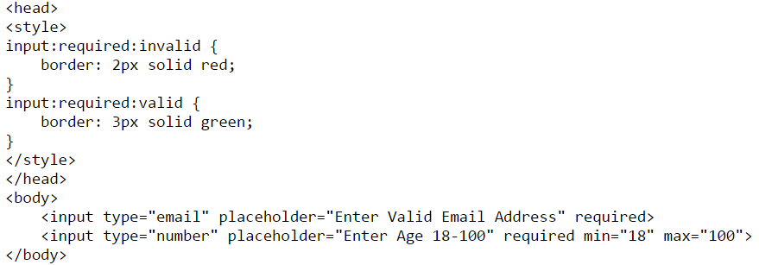
Form Validation
HTML5 gives you convenient types for form input
Date, time, email, password etc
CSS pseudoclasses can be used to change the appearance of these elements based on whether the input is valid

Slide 13
DHTML
What is DHTML?
Not a language in itself
Don’t write in DHTML markup language, or save in .DHTML file
Simply techniques for combining several other technologies
JavaScript
CSS
HTML
Example uses
Event detection (e.g. mouse-over)
Pop-up windows
Form validation
Displaying/hiding elements

Slide 14
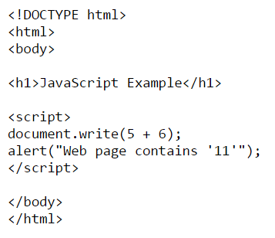
JavaScript
JavaScript is a scripting language very broadly supported by browsers
Used to add functionality to the otherwise mostly static pages that can be created with HTML + CSS
Dynamically typed
<script> tag is used to indicate a block of JavaScript within HTML
Not really anything to do with Java, though syntactically alike
alert() pops up a dialog
.write appends content to the specified HTML

Slide 15
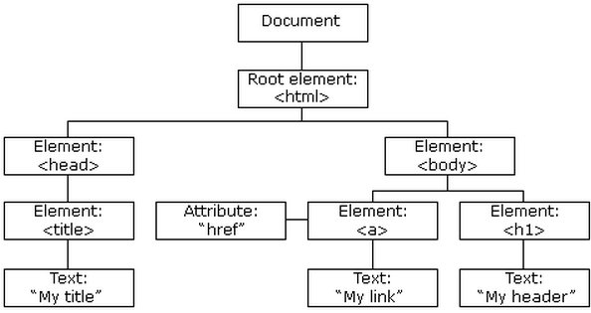
The Document Object Model (DOM)
The HTML DOM is a standard object model and programming interface for HTML, it defines:
The HTML elements as objects
The properties of all HTML elements
The methods to access all HTML elements
The events for all HTML elements
Tree structured
Mostly accessed using JavaScript

Slide 16
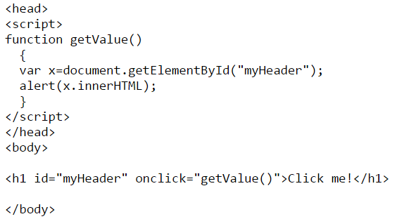
Referencing the DOM with JavaScript
In the DOM, HTML elements are objects with properties and methods
The id property value of individual elements can be set during their HTML declaration
Using JavaScript, we can then refer to different elements in the document by passing this id to the getElementById() method
HTML defines several properties such as onclick which allow you to specify events that will trigger JavaScript
Like in other languages, JavaScript allows you to define your own functions

Slide 17
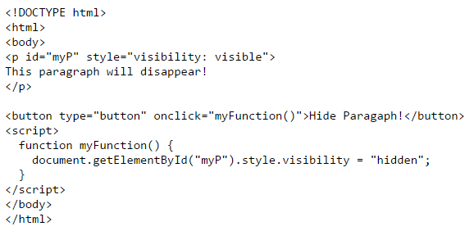
Dynamically changing visibility with DOM
Using the visibility CSS property of elements in combination with JavaScript we can dynamically change whether elements appear on a page
In this example, the paragraph “myP” will disappear when the button is pressed

Slide 18
Exercise
Using the techniques covered in this tutorial, create a web page with a single “Login” button
When this button is pressed, have the web page display a login form which utilizes form validation

Slide 19
Tutorial links
W3Schools
HTML: http://www.w3schools.com/html/
CSS: http://www.w3schools.com/css/
JavaScript: http://www.w3schools.com/js/

